Slide 1
McDonald’s Weekly Operations Review – Week 29
13th July 2025 – 19th July 2025

Slide 2
Agenda
1
Key Actions
2
Highlights for the past week
3
Volumetric Trends | INC, CHG, SR
4
Ticket classifications based on Business Services

Slide 3
Risk Register
Risk Description | Priority | Risk Owner | Risk Response | Identified On | Target Date | Status | Review Date
SDWAN - No ISP Redundancy for 21 SDWAN Sites | High | Angel Satcher | US - 9, APAC- 7, EU - 8 Sites have No ISP redundancy/Site running on single Router with Single ISP. | 2023 | TBD | Open | Monthly
MHQ & 711 Switches Out of Support | Moderate | Sudarshan | The Switches under MHQ & 711 switches are out of smart net support and End of Support. New switches have been procured and are at MHQ and switch replacement activity is in progress. | 2024 | Jan 2025 | Open | Monthly
CNF| R07 is single point of failure | High | Hamad Abbasi | R08 in production for Accenture / US Market and Yorktel. All the markets will start getting redundancy over R7/R8 in each CNF for US in 1st phase | 2023 | End of 2025 | Inprogress | Monthly
User testing post Change implementation | Moderate | Sudarshan/Angel | Post any change implementation during on/off business hours the users are unavailable to test the connectivity, also test the change output as all the McDonalds end users are unavailable which leads to issues being reported at a later point in time. | 2024 | N/A | Open | Monthly
Saskatoon & Regina Office Closure | Moderate | Sudarshan | Sites have been decommissioned in Nov 2024, however Regina Expereo link is still active, Sudarshan is working with Expereo to decommission the link | 2024 | Q2 2025 | Open | Weekly
Meraki Security Appliance Hardware Limitation | Moderate | Sudarshan/Angel | MX84 and MX100 are not supported above 18.1*** image. There are 12 devices that falls under “Product Firmware Version Restrictions”. Risk: , If there are any bugs identified on this current version, the only option is to perform a hardware upgrade, as per TAC. | 2024 | TBD | Open | Monthly
CNF IOS Upgrades | High | Hamad Abbasi | All CNF Routers upgraded on 17.9.5a, for all the 6 CNFs | 2024 | Q1 2025 | Closed | Monthly
License | High | Sudarshan/Tim | DNAC License Renewal | 2025 | Q2 2025 | Open | Weekly
Firewall Access | High | Joy/Soumik | Port 80 allowed in the CNF network over firewall | 2025 | Q2 2025 | Open | Weekly

Slide 4
P1/P2 - Critical incidents received for the past week
0 P1 and 0 P2 user incidents reported last week however it was not a potential P2.
P1|P2 troubleshooting calls that network team got involved in the past week (with /without ticket in Cognizant groups) - 0
Number | Created | Short Description | State | Priority | Status

Slide 5
Network Highlights for the Week
CNF
McDonald’s Offices
We have performed IOS from 17.12.4a IOS from bundle mode to install mode and install SMU file to mitigate Memory Leak issue on R5 Router.
We have installed Patch 6 to mitigate Vulnerability - CVE-2025-20281
SDWAN
NOC Hypercare
We have performed the Power Up activity for Network Equipment at MHQ
Hypercare Communication || CHG9135177 - US || PROD|| Replacement of Chicago R5 router (USMCCCCHIIL01R05) RMA- 804117556
Hypercare communication mail - Power up MHQ Network
Hypercare Communication || CHG9137329- US || PROD|| IOS Convert from 17.12.4a IOS from bundle mode to install mode and install SMU file to mitigate Memory Leak issue on R5 Router
No Major Changes implemented during this week as we are in the year end BPP.
Total Hypercare Hours for the week:144
5

Slide 6
Volumetric Trend for the past 29 weeks – INC | RITM
INC | Week 26 | Week 27 | Week 28 | Week 29
P1 | 0 | 0 | 0 | 0
P2 | 3 | 1 | 0 | 3
P3 | 640 | 210 | 177 | 1725
P4 | 456 | 460 | 637 | 1885
Total | 1099 | 671 | 814 | 3613
RITM | Week 26 | Week 27 | Week 28 | Week 29
P1 | 0 | 0 | 0 | 0
P2 | 0 | 0 | 0 | 0
P3 | 62 | 7 | 53 | 54
P4 | 21 | 38 | 5 | 7
Total | 83 | 45 | 58 | 61
Major contributors are Node Down/unreachable alerts –968, Interface down alerts –1667, Interface Error/ Utilization based alerts –260, QROC based alerts - 469 – Others - 150
Total RITM raised for the Week 29 is 61, Fulfilled – 22

Slide 7
Volumetric Trend for the past weeks – INCs Segregation by Created-Resolved by
12 out of 19 manually created tickets are by users/partners.
Manual Tickets raised by Internal Support Team
Assignment Group | Ticket Count
Akamai CDN service | 0
Cognizant Network Firewall | 10
Cognizant Network Ops | 2
Cognizant Network Ops L2/L3 | 7
External Protection API | 0
SASE Incident Support | 0
Total | 19

Slide 8
Tickets Handled Trends - INC & RITM
Total Incidents raised for the week 29 is 3613.
Major contributors are Node Down/unreachable alerts –968, Interface down alerts –1667, Interface Error/ Utilization based alerts –260, QROC based alerts - 469 – Others - 150
Total RITM raised for the Week 29 is 61, Fulfilled – 22

Slide 9
Volumetric Trend for the past 29 weeks – Change Requests handled
Type | Week 26 | Week 27 | Week 28 | Week 29
Automated Change | 31 | 31 | 27 | 1
Expedited Exception | 7 | 3 | 4 | 3
Emergency | 1 | 1 | 2 | 2
Normal | 10 | 3 | 10 | 6
Informational | 6 | 7 | 4 | 1
Total | 55 | 45 | 47 | 13
Closure Type | Week 26 | Week 27 | Week 28 | Week 29
Successful | 55 | 45 | 44 | 66
Successful with issues | 0 | 0 | 3 | 0
Unsuccessful | 0 | 0 | 0 | 0
Total | 55 | 45 | 47 | 66
66 successful changes for Week 29

Slide 10
Business Service classification (INC, RITM & Changes) – Weekly
Business Service - INC | Week 26 | Week 27 | Week 28 | Week 29
Cloud Edge - Network (CNF) | 82 | 88 | 159 | 184
Cloud Managed Network LAN & Wifi (US & Canada) | 38 | 25 | 27 | 58
Cloud Edge Firewall | 12 | 6 | 4 | 21
Cognizant QROC log aggregation and correlation | 5 | 6 | 10 | 482
Content Delivery Network (CDN, Akamai) | 2 | 0 | 1 | 0
Internet Application Protection | 0 | 1 | 0 | 0
Firewall / SASE | 0 | 11 | 0 | 0
SD-WAN | 226 | 244 | 390 | 428
Managed WIFI/LAN | 731 | 290 | 221 | 2440
WAN - ATT | 0 | 0 | 0 | 0
WAN - Cognizant | 0 | 0 | 0 | 0
Grand Total | 1099 | 671 | 814 | 3613
Business Service – RITM | Week 26 | Week 27 | Week 28 | Week 29
Cloud Edge - Network (CNF) | 3 | 6 | 8 | 7
Cloud Edge Firewall | 35 | 21 | 31 | 27
Cloud Managed Network LAN & Wifi (US & Canada) | 3 | 0 | 0 | 2
Cloud Managed Network LAN & Wifi (EU & APMEA ) | 0 | 0 | 0 | 0
Cognizant QROC log aggregation and correlation | 2 | 0 | 5 | 5
Content Delivery Network (CDN, Akamai) | 6 | 2 | 3 | 4
IP Allocation Management (IPAM) | 4 | 1 | 5 | 3
Managed WIFI/LAN | 8 | 5 | 2 | 8
External Surface Protection | 0 | 2 | 0 | 0
Firewall / SASE | 0 | 3 | 0 | 0
SD-WAN | 2 | 5 | 4 | 5
VPN | 0 | 0 | 0 | 0
WAN - Cognizant | 0 | 0 | 0 | 0
Grand Total | 63 | 45 | 58 | 61
Business Service - Change Requests | Week 26 | Week 27 | Week 28 | Week 29
Cloud Edge - Network (CNF) | 11 | 6 | 8 | 13
Cloud Edge Firewall | 28 | 23 | 23 | 33
Firewall / SASE | 0 | 7 | 0 | 0
Cloud Managed Network LAN & Wifi (EU & APMEA) | 0 | 0 | 0 | 0
Cloud Managed Network LAN & Wifi (US & Canada) | 1 | 0 | 2 | 0
Cognizant QROC log aggregation and correlation | 0 | 0 | 0 | 0
SDWAN | 1 | 4 | 3 | 1
Content Delivery Network (CDN, Akamai) | 7 | 2 | 8 | 15
Internet Application Protection | 0 | 2 | 0 | 0
IP Allocation Management (IPAM) | 0 | 0 | 0 | 0
Managed WIFI/LAN | 7 | 1 | 3 | 6
Grand Total | 54 | 41 | 47 | 68
Major contributors are Node Down/unreachable alerts –968, Interface down alerts –1667, Interface Error/ Utilization based alerts –260, QROC based alerts - 469 – Others - 150

Slide 11
Top 4 Issue Types for Week 2
Issue Type | INC Count | Issue Description | Observation | Actions Taken-Recommendation-Comments
Interface Down alerts | 1667 | Link connecting to Interface is Down | MHQ – 1553 CMN –18 SDWAN – 86 CNF – 10 | 1553 MHQ alerts triggered due to Power Up Network Equipment at MHQ due to which the AV, video devices etc interfaces got flapped. 18 CMN Alerts triggered due to network interface status flap connected to Xerox/printer and user ports. 86 SDWAN alerts triggered due to TLOC link down and flap on Delhi devices and for Slovenia and Portugal devices due to WAN link down and interface flap. 10 CNF alerts triggered due network interface down as interface Tunnel’s were flapping for Chicago R05 and Ashburn R05
Interface Utilization / Error Rate alerts | 260 | Interface Errors / Utilization ​transmit-Receive | SDWAN – 224 MHQ – 14 CNF – 22 | 224 SDWAN alerts triggered due to high utilization on the interface bandwidth. 14 MHQ alerts triggered due to clear interface discard error rate. 22 CNF alerts triggered due to clear interface discard error.
Node unreachable alerts | 968 | Devices were unreachable due to ISP-Power issues.​ | CMN – 23 SDWAN – 75 MHQ – 800 CNF – 60 | 23 CMN Alerts triggered due to device flap for Oakbrook and aviation center. 75 SDWAN alerts triggered due to major issue with the country main POP at Cairo Egypt region and received few false positives for different markets. 800 MHQ alerts triggered due to Power outage and Power Up Network Equipment at MHQ due to which the AV, video devices etc. interfaces got flapped. 60 CNF – We have received multiple alerts for different devices; however, they appear to be false positives, as all the devices are reachable.
QROC offense related incidents | 469 | QROC alerts when a suspicious activity is observed | Most cases belongs to Rule name (GL - Global_Palo_CNF_SAN_RICH_Firewall_Outbound_Transfer_to_RemoteAddress_Data_Exfiltration) triggered more than 450 incidents. | This was due to expected communication between the firewall management server IPs and Palo Alto's DNS Security servers, which began after the Advanced DNS Security license was enabled on July 11, 2025. This activity is now considered normal and expected.

Slide 12
Aging Tickets Status > 10 days
Aging Incident : 1
Aging RITM : 11
Number | State | Assigned to | Priority | Short Description
INC17429202 | Pending User | Majo Kunnassery | 4 - Low | Networking dropping in 5SW corner of MHQ
Number | State | Short description | Priority | Assigned to
RITM11924499 | Pending Change | Adding TV boxes to MCD Toronto office | 3 - Moderate | Sridip Pramanik
RITM11924137 | Pending User | Addition of Syslog segment - US-100.105.40.0/27 devices | 3 - Moderate | Sridip Pramanik
RITM11926442 | Pending User | Allow access for office and GRA subnets to access file servers in AWS | 3 - Moderate | Anandapadmanaban K
RITM11925759 | Pending Tasks | Allow PL Market users and LABs to Acrom on-site server |McDonald's Poland Testing Automation Project | 3 - Moderate | Sai Prasanth Vaddadi
RITM11919444 | Pending Change | CNF Routes for GMAL MOP | 3 - Moderate | Balamurugan C
RITM11921855 | Pending Change | MHQ and 711 devices are not captured in the Cribl | 4 - Low | Tarun Shee
RITM11920289 | Pending User | open ports for 3PO | 4 - Low | Arunkumar Kathirvel
RITM11918125 | Pending Change | UK EF - VMO2 cloud connect - accept prefixes from O2 | 3 - Moderate | Arunava Roy
RITM11925940 | Pending Tasks | Unused rules review for Toronto Firewall | 3 - Moderate | Brindha S
RITM11913964 | Pending Change | Yorktel/Amsterdam. Request for additional VPN Tunnel | 4 - Low | Arunava Roy
RITM11913965 | Pending Change | Yorktel/Frankfurt. Request for additional VPN Tunnel - | 4 - Low | Arunava Roy

Slide 13
CNF Link Utilization for Week 29
Incident # | Average Utilization | 95th Percentile | Remarks
Chicago CNF | 8% | 35% | No Anomalies reported
Ashburn CNF | 6% | 8% | No Anomalies reported
Frankfurt CNF | 9% | 14% | No Anomalies reported
Amsterdam CNF | 11% | 18% | No Anomalies reported
Hong Kong CNF | 1% | 1% | No Anomalies reported
Singapore CNF | 13% | 29% | No Anomalies reported

Slide 14
Breach analysis (INC, RITM & Change Requests) for Week – 29
Incidents :
RITM :
Incident SLA :
No defaulters for the week.
Completion SLA :
No defaulters for the week.
Change Requests :
Actions taken:
Process SLA :
No defaulters for the week.
Process SLA :
No defaulters for the week

Slide 15
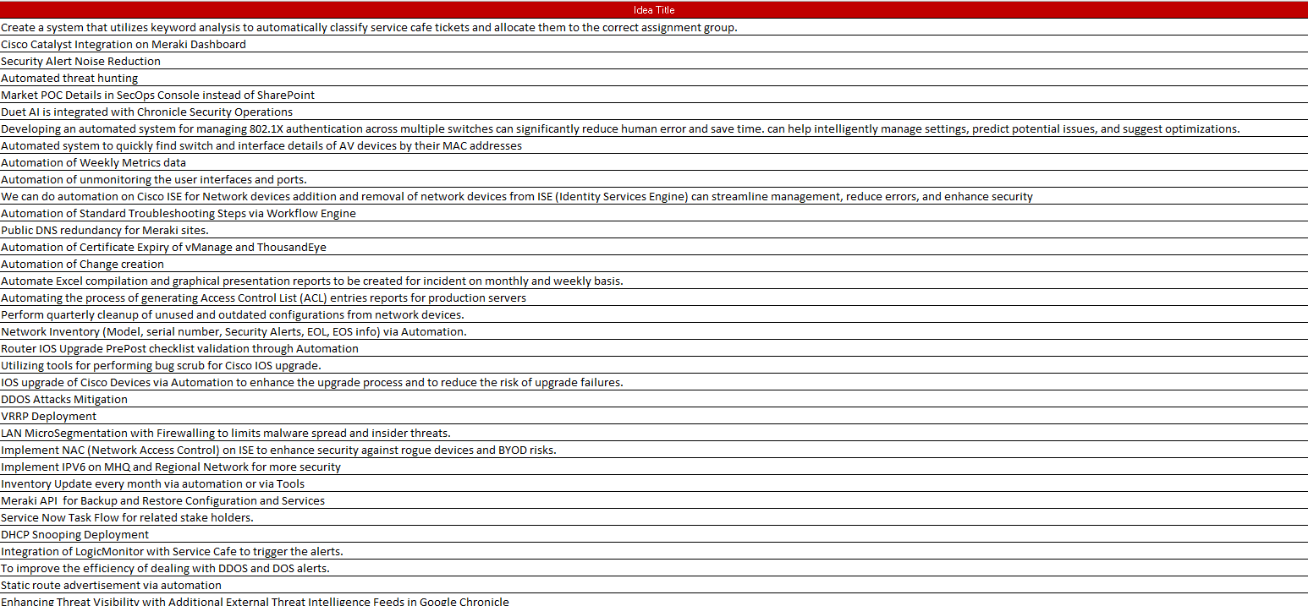
Cognizant Bluebolt Initiative

Slide 16
Thank You!

Slide 17

Appendix

Slide 18
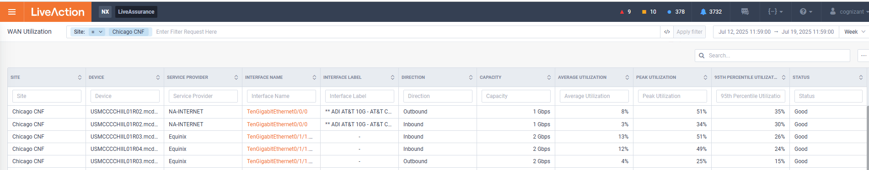
Network Performance
Chicago Network Utilization for the Week 29
No anomaly for the week 29

Slide 19

Ashburn Network Utilization for the week 29
Network Performance
No anomaly for the week 29

Slide 20
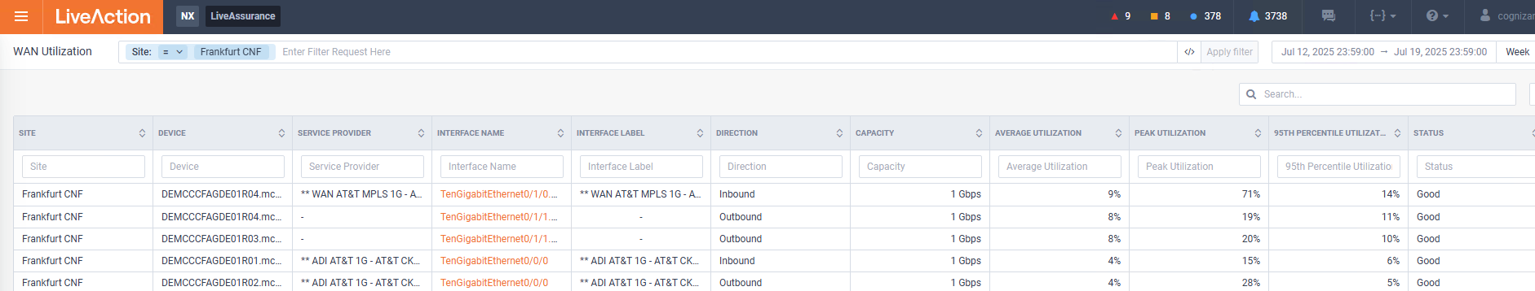
Network Performance
Frankfurt Network Utilization for the week 29
No anomaly for the week 29

Slide 21
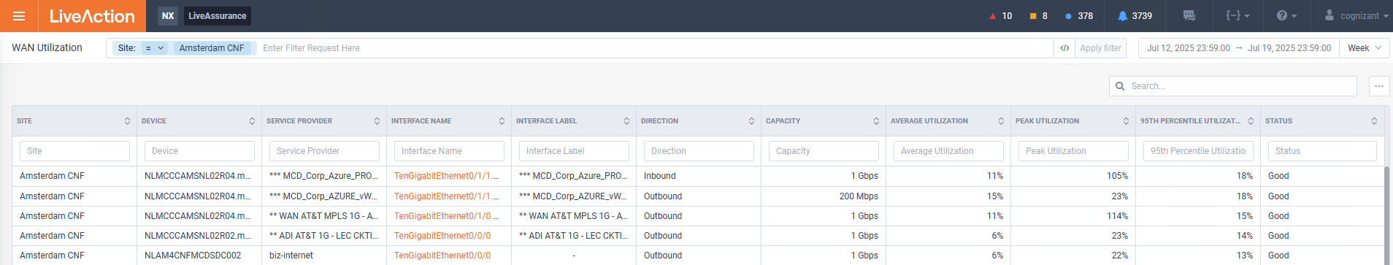
Network Performance
Amsterdam Network Utilization for the week 29
No anomaly for the week 29

Slide 22
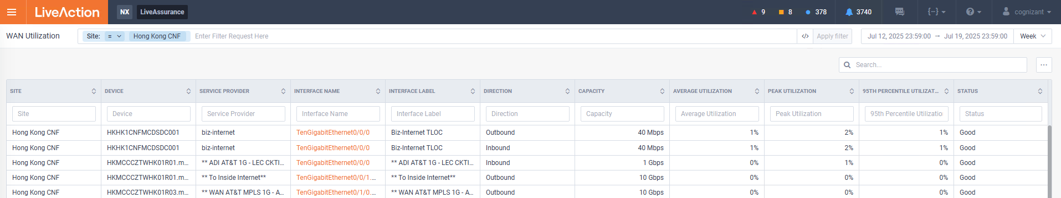
Network Performance
Hong Kong Network Utilization for the week 29
No anomaly for the week 29

Slide 23
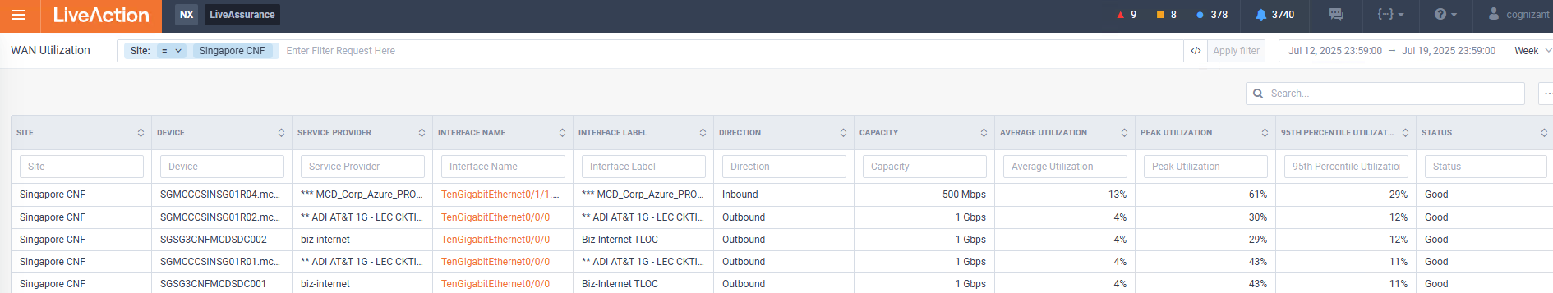
Network Performance
Singapore Network Utilization for the week 29
No anomaly for the week 29

